Slide 1
AUTHORITARIANISM AND CENSORSHIP
Team: Lim Guanray, Ong Jayden

Slide 2
Purpose
What is it about
Main Objective
Design Choices
Our interactive website educates the viewer on the evolution of authoritarianism in our system of governments throughout history and how they have used censorship in order to assert their role in leadership.
In this new world order where authoritarianism is on the rise, we want people to realise what is happening around them and why they should care through describing the impacts that has happened throughout history.
We went with an easy to follow simplistic design based on the template ChariTeam.

Slide 3

Story (Our Motivation)
In status quo, we have seen a shift of perception from democracies to favouring authoritarianism as it provides stability. However, we have also seen how big powers are using their absolute power in order to make decisions that are in their interest, not the common people, and how they’ve used propaganda to shape our perception.

Slide 4

Target Audience
We want this interactive website to be accessible by ordinary people, especially ones who are frequently targeted by misinformation and propaganda.
This website isn’t supposed to be a complete informational page on everything, rather it’s a wake-up call for us to understand what is going on around us.

Slide 5




Tools and Technologies
HTML
CSS
JavaScript
React.js

Slide 6
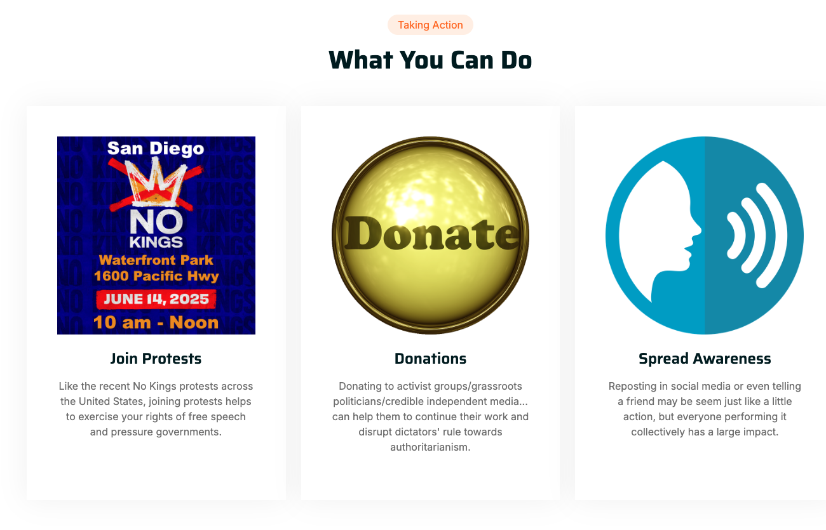
Key Features
Introduction
Void Background + Dictator Profile
Call to Action
Short context on what is authoritarianism
The void background represents a sense of darkness
Shares ways to users on how to take action

Slide 7
Enhancements
Content Proposal
World Leaders Leaderboard
Is My Leader A Dictator?
Having a feature that allows users to contact website authors to add more authoritarian leaders into the list.
Rank and compare major contemporary world leaders based on their social policy (authoritarian-libertarian) standings according to the Political Compass.
Create forums for discussion on whether certain leaders act authoritarian.

